Slide 1

Hierarchical Alternating Optimization For Enhanced 6DMA-Assisted Over-the-Air Computation
Junjie Gao, Bin Yan, Rui Ma, Zheng Wang, Yongming Huang
School of Information Science and Engineering
Southeast University, Nanjing, China
junjiegseu@gmail.com
Paper ID : CT3323
Notes:
Good morning, distinguished chairs and colleagues. I am Junjie Gao from Southeast University. It is my privilege to present our work Hierarchical Alternating Optimization for Enhanced 6DMA-Assisted Over-the-Air Computation.

Slide 2


Part 01
Background
Part 02
System Model & Problem
CONTENTS
Part 03
The Proposed HAO Algorithm
Part 04
Simulation Results

Slide 3

I -
Background
Over-the-Air Computation (AirComp) enables a base station to compute a function over distributed data from massive IoT devices.
Existing works of Aircomp & Their Limitations
Transceiver Optimization: Optimizes transmit power and receive beamforming.
Reaches its fundamental limit.
Traditional movable antennas: Adjusts antenna positions to find better channels.
Limited spatial degrees of freedom.
Notes:
Over-the-air computation has emerged as a pivotal technology for efficient data aggregation in IoT networks. It enables simultaneous transmission and computation, significantly enhancing spectral efficiency. However, conventional systems face fundamental limitations due to wireless channel impairments.Existing approaches encounter critical constraints. Transceiver optimization has reached its performance bound, while traditional movable antennas provide limited spatial degrees of freedom.

Slide 4
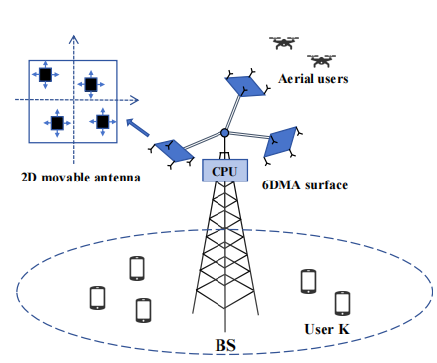
I -
Background
We propose an enhanced six-dimension movable antenna (6DMA) system.
Two Levels of Reconfigurability:
Surface-Level Configuration: controls the 3D position and 3D rotation of each antenna surface.
Antenna-Level Configuration: allows individual antennas to move in a 2D plane within their surface.
Notes:
To overcome these limitations, we propose an enhanced 6-dimension movable antenna namely 6DMA architecture. Traditional 6DMA systems already represent a significant advancement by enabling its surfaces to adjust their 3D positions and rotations. However, they maintain fixed antenna arrangements within each surface, Our enhanced 6DMA introduces a crucial innovation: while preserving surface-level mobility, we enable individual antennas to move within 2D planes on their surfaces. This architecture reconfigurability creates unprecedented spatial diversity.

Slide 5
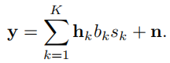
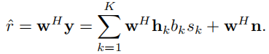
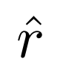
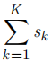
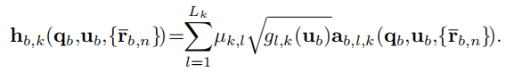
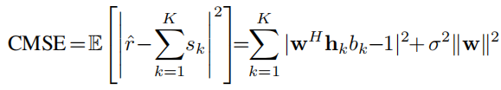
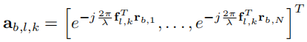
Received signal of all users:
BS Processing:
II -
System Model & Problem
System
• K single-antenna users.
• B Enhanced 6DMA surfaces at the BS.
• Each surface contains N movable antennas.
Target: Minimize the distortion between the estimate
and the target .
Minimize the Computation Mean Square Error (CMSE)
The channel from user k to antennas on the b-th enhanced 6DMA surface:
Notes:
The system architecture comprises K single-antenna users and a base station equipped with B enhanced 6DMA surfaces. Each surface contains N movable antennas configured in a uniform planar array.
The channel from user k to antennas on surface b is modeled as a multi-path channel,here LK represents the number of propagation paths between user k and the base station.For each path l, we have μk,l which is the path coefficient,The term gl,k is the effective antenna gain that depends on the surface rotation and the direction of arrival of the signal. Finally, the array response vector ab,l,k captures the phase differences across different antenna elements due to their spatial positions. the overall channel response is jointly influenced by surface position and rotation and the antenna displacements in each surface.
Within the over-the-air framework, all users simultaneously transmit their data symbols. The base station receives a superimposed signal containing transmissions from all K users. Specifically, the received signal at the BS can be expressed as the sum of all users' transmitted signals through their respective channels, then the bs applies a receive combining vector to process this composite signal and produce an estimate of the target computation function. Our objective is to minimize the Computation Mean Square Error (CMSE), which measures the distortion between the estimated function value and the actual target value.

Slide 6
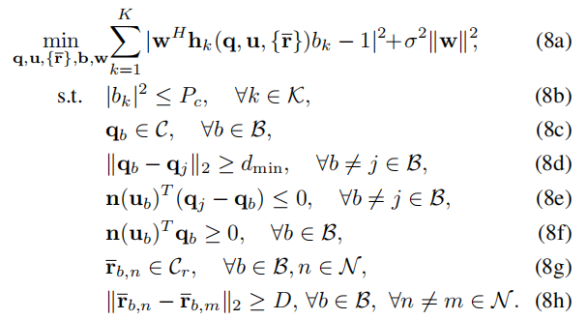
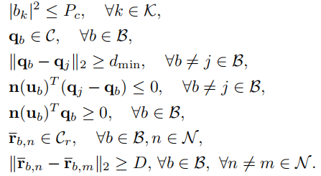
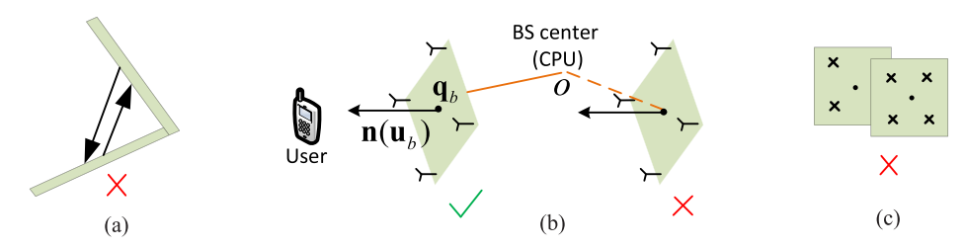
II -
System Model & Problem
Joint Optimization Problem:
Subject to the following constraints:
Figure: Constraints on the rotations and positions of 6DMA surfaces^{[1]}.
[1] X. Shao, Q. Jiang, and R. Zhang, “6D movable antenna based on user distribution: Modeling and optimization,” IEEE Transactions on Wireless Communications, vol. 24, no. 1, pp. 355-370, Jan. 2025.
Notes:
The optimization problem involves joint determination of surface configurations, antenna positions, and transceiver parameters, subject to comprehensive physical constraints including power limitations, mechanical constraints, and specific 6DMA movement constraints such as minimum inter-surface distance to avoid overlap and mutual coupling, rotation constraints to prevent mutual signal reflection between surfaces, and orientation constraints to avoid signal blockage by the central processing unit.

Slide 7
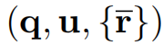
III - The Proposed HAO Algorithm
Hierarchical Alternating Optimization (HAO)
Phase 1: Transceiver Design
Phase 2: Enhanced 6DMA Configuration
Fixed enhanced 6DMA configurations
Alternating optimization of b and w with closed-form solutions
Optimize using Moth-Flame Optimization (MFO)
Fitness function: CMSE + constraint violation penalty
Untill convergence
Notes:
To address this complex joint optimization challenge, we propose a hierarchical alternating optimization (HAO) framework that decomposes the problem into two subproblems.The algorithm operates through an iterative two-phase process.
In Phase 1, with fixed antenna configurations, we derive closed-form solutions for transceiver design - obtaining the MMSE receive combiner and optimal transmit coefficients.
In Phase 2, maintaining optimized transceiver parameters, we employ moth-flame optimization to tackle the antenna configuration space. This phase optimizes surface positions, rotations, and individual antenna displacements using a specialized fitness function that balances computation accuracy with constraint satisfaction. Crucially, these two phases alternate iteratively until convergence.

Slide 8
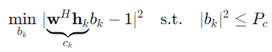
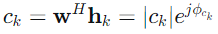
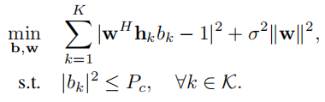
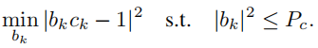
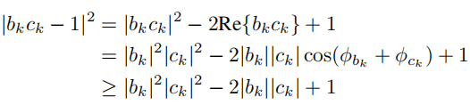
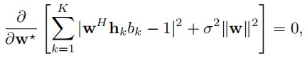
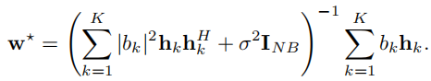
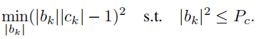
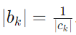
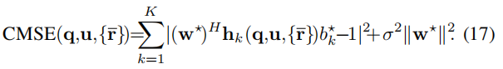
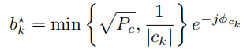
Optimizing b with fixed w:
III - The Proposed HAO Algorithm
Problem decouples across users k:
Optimizing w with fixed b:
The optimization of w becomes an unconstrained quadratic problem.
Define the effective channel:
Phase 1: Transceiver Design
To be more specific, the subproblem for user k is:
Set the gradient w to zero.
the optimal phase of bk is
The unconstrained solution is
Truncated Solution due to power constraint:
Notes:
In Phase 1, we optimize the transceiver design through alternating optimization with closed-form solutions.
For the receive combiner, with fixed transmit coefficients, the optimization problem becomes an unconstrained quadratic problem. By setting the gradient of the objective function to zero, we obtain the closed-form MMSE solution.For the transmit coefficients, with fixed combiner, we observe that since each term in the summation involves only a single variable b_k, the problem can be decomposed into K independent subproblems.Through analysis of the optimality conditions, we find the optimal solution combines phase compensation with magnitude optimization.
We alternate between these updates until convergence, with each iteration guaranteeing monotonic improvement of the CMSE objective function.

Slide 9
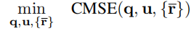
III - The Proposed HAO Algorithm
Phase 2: Enhanced 6DMA Configuration
Optimizing Antenna Configuration
Solution: Moth-Flame Optimization (MFO)
complicated non-convex problem.
A population-based heuristic algorithm.
Spiral movement covers search space more thoroughly.
Balances exploration and exploitation.
are coupled with each other.
Where:
w and b are obtained from Phase 1 for the given antenna configuration.
Notes:
In Phase 2, we tackle the core challenge of optimizing the antenna configuration. The problem is formulated as minimizing the CMSE with respect to surface positions, rotations, and antenna displacements, while satisfying all physical constraints.
This optimization problem presents challenges due to three key factors: first, the objective function is highly non-convex because channel responses depend on antenna positions in a complex, nonlinear fashion; second, we face multiple nonlinear constraints including collision avoidance and orientation requirements; third, the optimization variables are strongly coupled.
To overcome these difficulties, we employ Moth-Flame Optimization, which offers distinct advantages: its spiral movement mechanism enables more local search around promising solutions compared to PSO's linear updates, while the adaptive flame management naturally balances global exploration and local refinement throughout the optimization process.

Slide 10
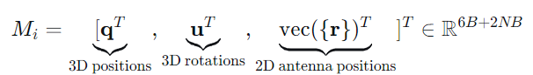
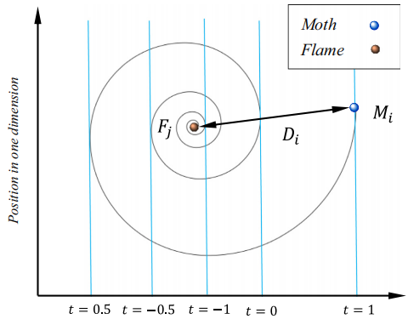
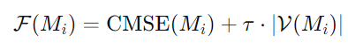
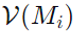
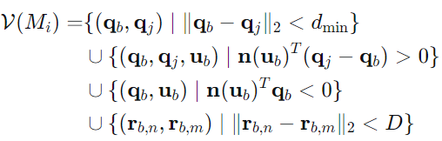
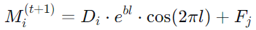
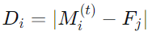
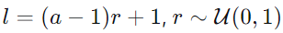
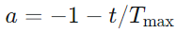
III - The Proposed HAO Algorithm
Each moth represents a complete enhanced 6DMA configuration:
Fitness Function:
V(Mi) represents a violated constraint:
Moth position update rule:
Moth-Flame Optimization
Figure: conceptual model of position updating of a moth around a flame^{[2]}.
[2] Shehab, M., Abualigah, L., Al Hamad, H. et al. Moth–flame optimization algorithm: variants and applications. Neural Comput & Applic 32, 9859–9884, 2020.
Notes:
Now let me explain how the MFO mechanism works in practice.
First, we initialize a population of moths, where each moth represents a complete antenna configuration - encoding surface positions, rotations, and all antenna displacements into a single high-dimensional vector.
To evaluate each candidate configuration while ensuring constraint satisfaction, we introduce a fitness function that augments the CMSE with a penalty term. (Here, V(Mi) denotes the set of constraint violations,andτis a sufficiently large penalty parameter.)
The core of MFO lies in its unique position update mechanism. Unlike traditional PSO that uses linear velocity updates, MFO employs a logarithmic spiral function. Each moth updates its position by flying in a spiral trajectory around its associated flame.

Slide 11
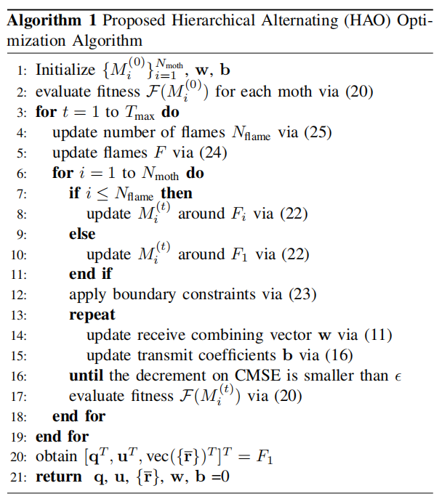
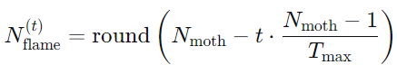
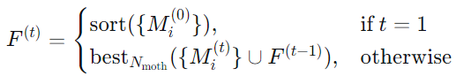
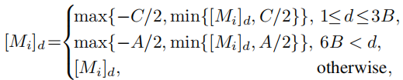
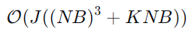
III - The Proposed HAO Algorithm
The Proposed HAO Algorithm
Adaptive Flame Number:
Flame Update Strategy:
Projection to Feasible Regions:
Computational Complexity Analysis
Phase 1:
Phase 2:
Overall Complexity:
Notes:
We implement an adaptive strategy for flame management. As iterations progress, we systematically reduce the number of flames, focusing the search on the most promising regions.( For flame management, we employ a competitive selection process. At each iteration, we combine the current moth population with previous flames and retain only the best solutions) .And we implement boundary projection to guarantee all solutions satisfy mechanical constraints.
Finally, to summarize, the proposed HAO approach is
presented in Algorithm 1. Clearly, we can observe that Phase
2 spans from line 3 to line 18, which constitutes the main
MFO iteration loop. Within this loop, Phase 1 is incorporated
from lines 13 to 16.
Now, let me address the computational complexity of our proposed HAO algorithm.
The complexity consists of two main components. For Phase 2, the MFO algorithm requires operations on the order of T_max times N_moth times M log M, where M equals 6B plus 2NB.
For Phase 1, each transceiver optimization demands computations scaling with J times NB cubed plus K times NB, where J is the number of iterations until convergence.
Since Phase 1 is embedded within Phase 2 and executed for every moth at each iteration, the overall complexity combines both components. Specifically, it's proportional to T_max times N_moth times the sum of J times NB cubed plus K times NB, plus M log M.

Slide 12
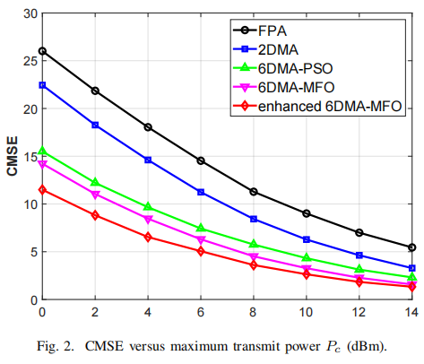
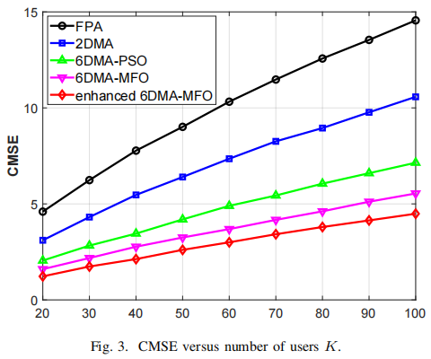
Ⅳ - Simulation Results
Enhanced 6DMA outperforms all benchmarks in both CMSE and scalability.
MFO optimization shows clear advantage over PSO in high-dimensional space
Notes:
Our simulation results demonstrate three key advantages of the proposed scheme:
First, the enhanced 6DMA architecture achieves significant performance gains, and outperforms all benchmarks in both CMSE and scalability.
Second, the system exhibits remarkable scalability, maintaining performance superiority as user density increases. This makes our approach particularly suitable for massive IoT applications.
Third, the MFO-based optimization consistently outperforms traditional methods, proving its efficacy in navigating complex high-dimensional spaces.
(These findings collectively confirm that our integrated approach of enhanced hardware architecture with sophisticated optimization algorithms delivers substantial improvements in computation accuracy and system reliability.)

Slide 13

Thank you for your watching
Junjie Gao, Bin Yan, Rui Ma, Zheng Wang, Yongming Huang
School of Information Science and Engineering
Southeast University, Nanjing, China

